Slide 1
Center for Transportation Studies
Connecting Research and Practice
MOMO Plenary Sept. 16, 2025

Slide 2
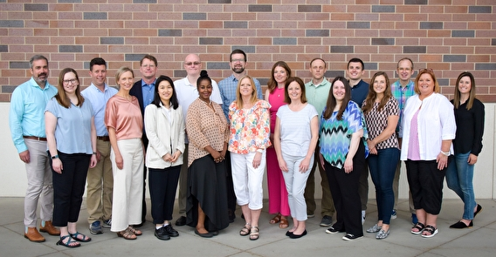
About CTS
Mission
CTS cultivates improvements and innovation in transportation through research, engagement, and education.
Vision:
In collaboration with public-sector, industry, and academic partners, CTS shapes transportation systems that are sustainable, serve the needs of all users, support a strong economy, and improve our collective quality of life.
CTS staff outside Huntington Bank Stadium
Notes:
CTS is the hub for transportation research and education at the University of Minnesota. It supports research in many disciplines, cultivates the transportation workforce, and shares new thinking with various stakeholders and audiences.

Slide 3
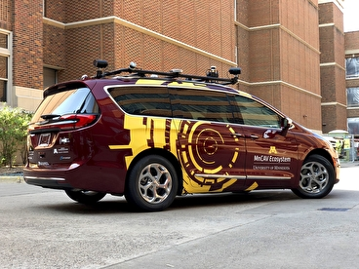
How we work
CTS coordinates efforts to strategically invest in research and partnerships that answer the most pressing transportation challenges of public partners and researchers.
CTS supports and develops the transportation workforce of the future.
CTS informs public policy and decision-making processes with research-driven conclusions.
CTS’s connected and automated research vehicle
Notes:
We produce and share leading-edge transportation research and technology, and we work with our partners to transfer findings into practice.
We serve our land-grant mission by deploying the University of Minnesota’s resources and expertise to address public needs.

Slide 4
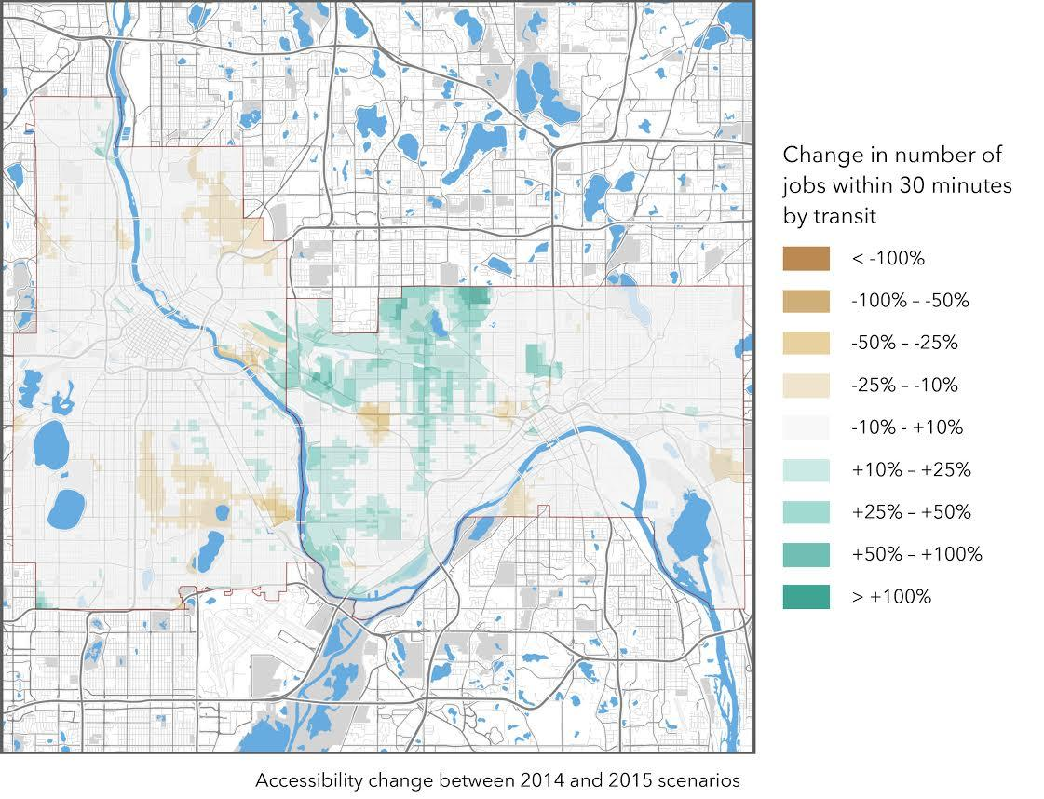
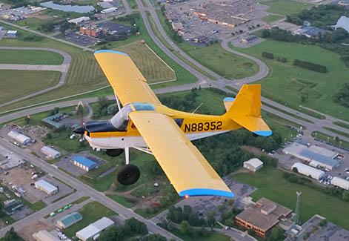
Major Programs
Minnesota Local Technical Assistance Program (LTAP)
Airport Technical Assistance Program (AirTAP)
MnCAV Ecosystem
Accessibility Observatory
Transportation Policy and Economic Competitiveness
Transitway Impacts Research Program
Journal of Transportation and Land Use

